Slide 2
Servo system in laser locks
Xiaoyu Jiang
2019/08/19

Slide 3
To lock the frequency of a laser:
Error Signal: PDH, Hansch & Couillaud,..
Servo loop filter: Apply the error signal to the laser with appropriate phase & amplitude.
Devices has finite frequency response(Example: Piezo transducer)
Feedback loop time delay(servo bump)

Slide 4
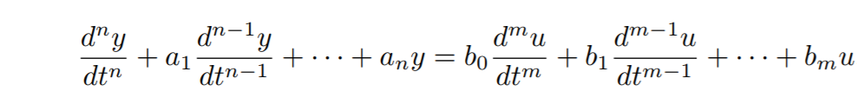
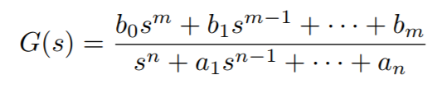

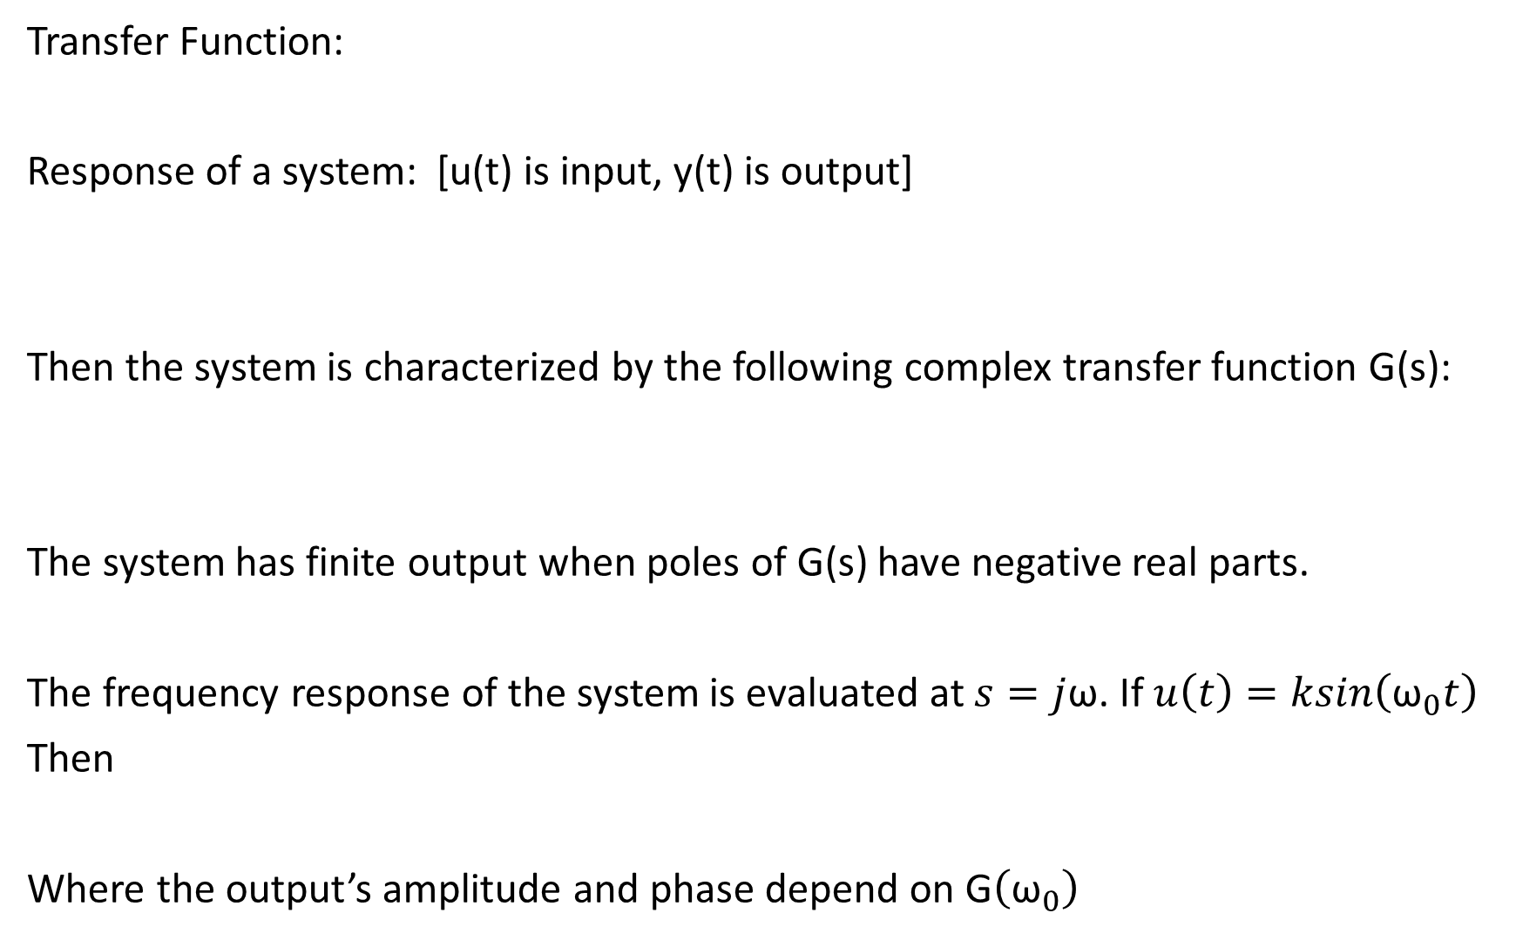
Transfer Function:
Response of a system: [u(t) is input, y(t) is output]
Then the system is characterized by the following complex transfer function G(s):
The system has finite output when poles of G(s) have negative real parts.
The frequency response of the system is evaluated at $s=j$ω. If $u\left(t\right)=ksin\left({\text{ω}}_{0}t\right)$
Then
Where the output’s amplitude and phase depend on G$\left({\text{ω}}_{0}\right)$

Slide 5
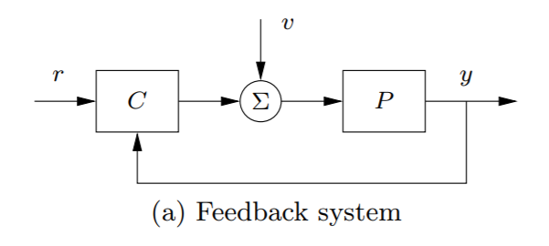
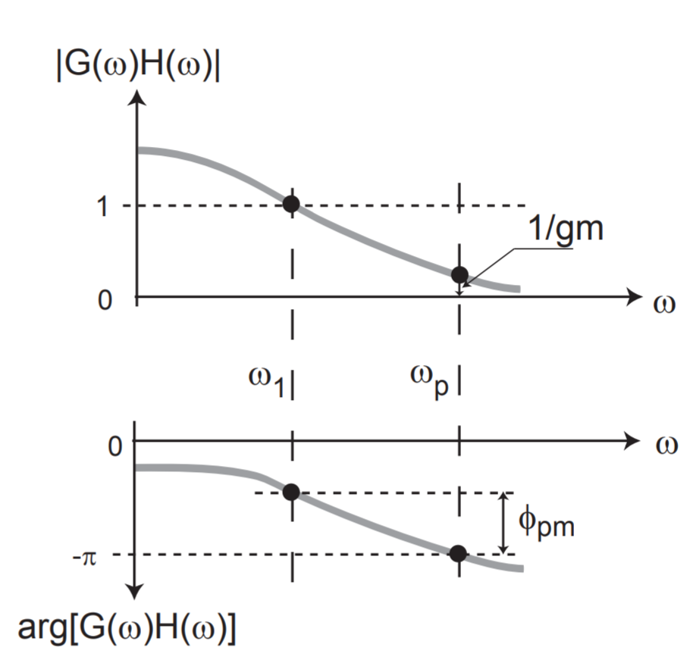
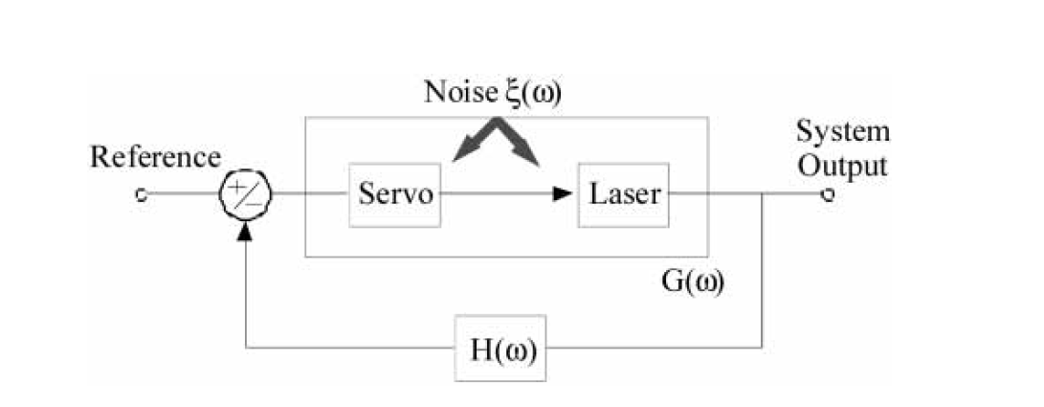

PDH(Slow loop only):
$V_{out}=G(V_{in}−H$ $V_{out}$)
$$\frac{V_{out}}{V_{in}}=\frac{G}{1+GH}$$
“Bode plot”
u

Slide 6
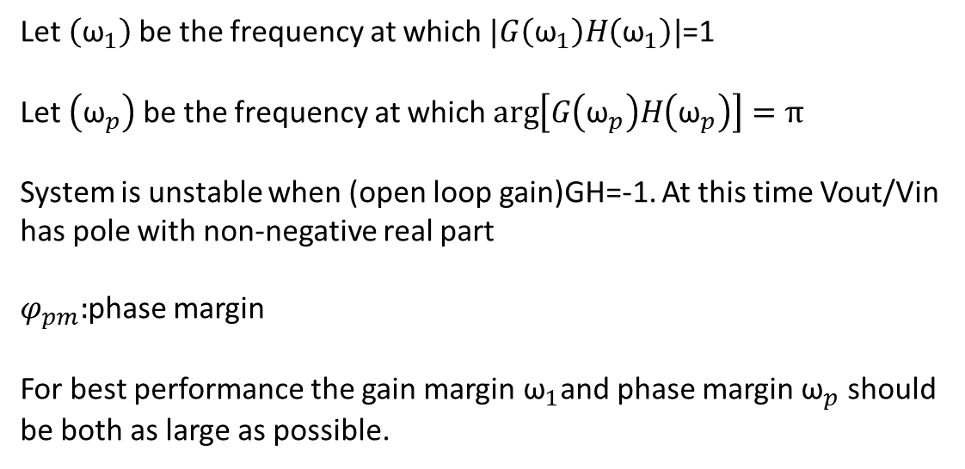
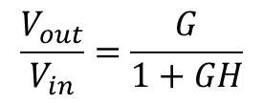
Let $\left({\text{ω}}_{1}\right)$be the frequency at which $|G\left({\text{ω}}_{1}\right)H\left({\text{ω}}_{1}\right)|$=1
Let $\left({\text{ω}}_{p}\right)$be the frequency at which $arg\left[G\left({\text{ω}}_{p}\right)H\left({\text{ω}}_{p}\right)\right]=π$
System is unstable when (open loop gain)GH=-1. At this time Vout/Vin has pole with non-negative real part
$φ_{pm}:$phase margin
For best performance the gain margin ${\text{ω}}_{1}$and phase margin ${\text{ω}}_{p}$ should be both as large as possible.
$$\frac{V_{out}}{V_{in}}=\frac{G}{1+GH}$$

Slide 7
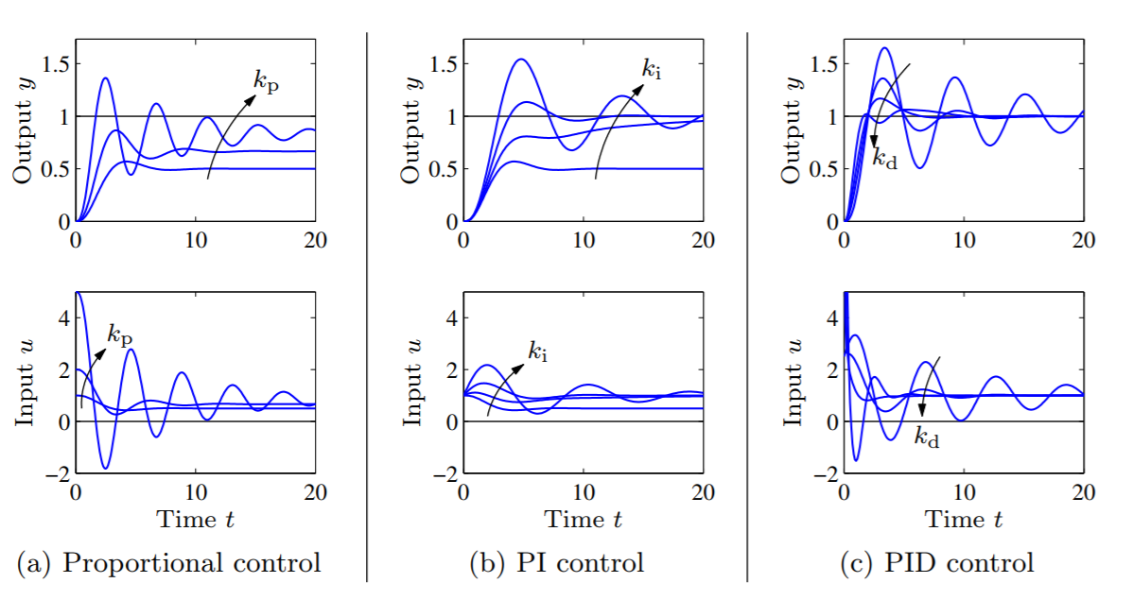
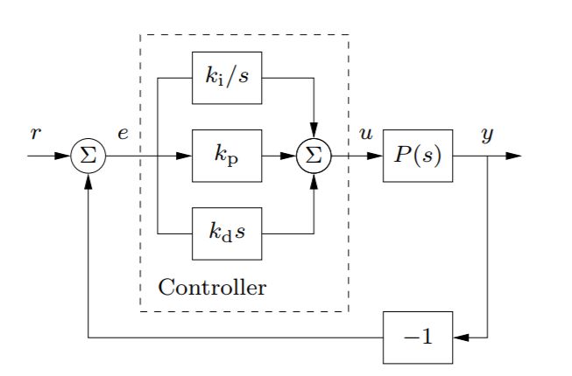
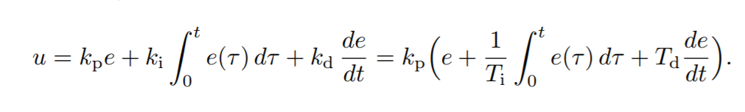
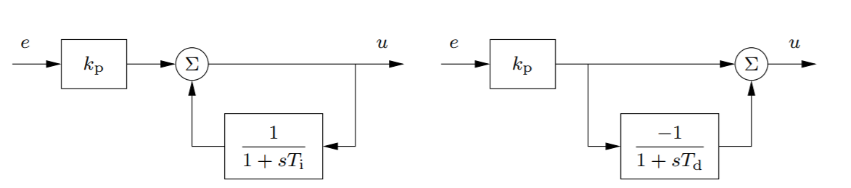
PID control:
P: Nonzero steady state-error
PI: If steady state exists the error will be zero
PID: Anticipate the system’s evolution

Slide 8
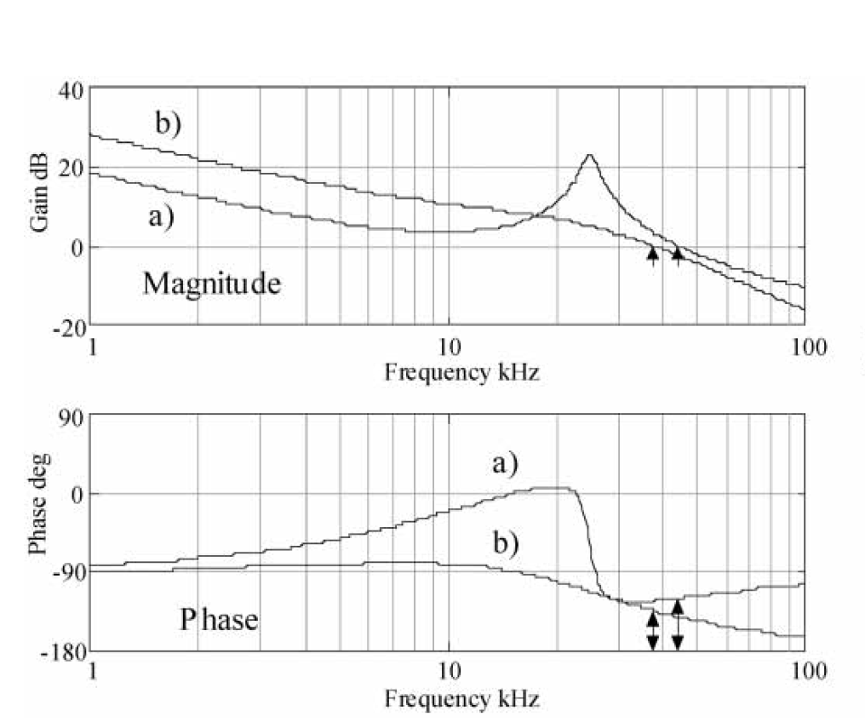
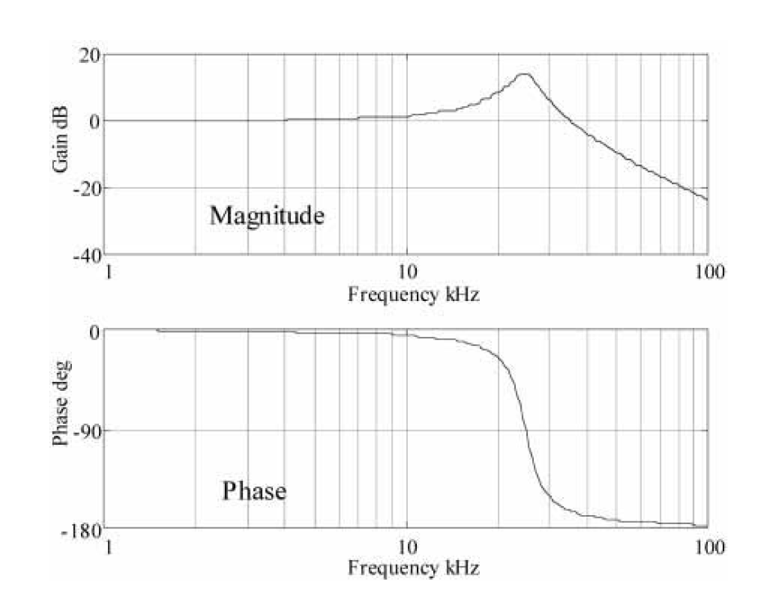
Using PID to increase unit gain frequency:(J.Hall, et al, 2004)
Frequency response of PZT with 25kHz resonance:
PID controller where the derivative term advances the phase near resonance

Slide 9
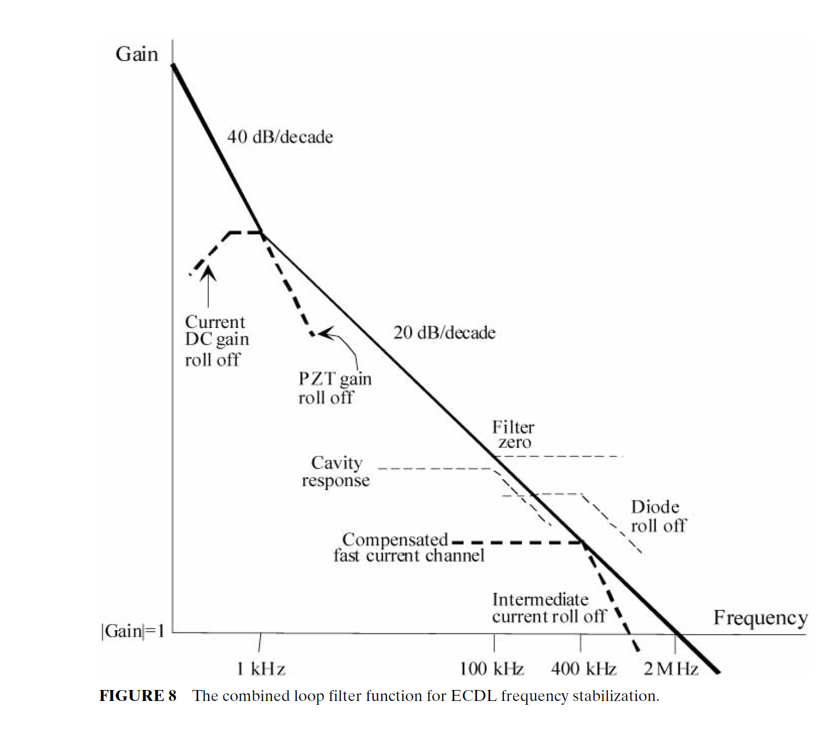
Practical feedback scheme:
slow
medium
fast

Slide 10
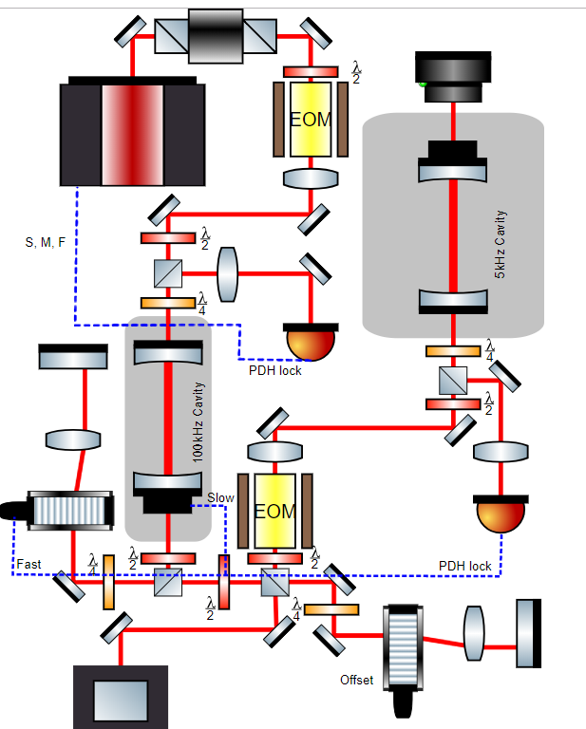
Servo bump：
Feedback loop takes finite time to react and feedback, making the bandwidth of the system limited.
Servo bumps appear when the phase delay of the feedback signal exceeds π and the feedback changes from negative feedback to positive feedback
Solution: Servo bump filtering cavity

Slide 11
Useful Reference:
1. The Electronics Engineers' Handbook, 5th Edition, McGraw-Hill, Section 19, pp. 19.1-19.30, 2005.
2. Feedback Control of Dynamic systems, 6th Edition, Gene.F.Franklin, 2010
3. Feedback Systems: An introduction for scientists and engineers, 2nd Edition, Karl J.Astrom.
4. Handbook of optics, Chapter 27, Hall et al
5. Mark’s optics note

